Slide 1
Winlink Documentation
Barb Schlueter, KD0WAU
CONTENTS
Winlink Introduction
What you need to setup Winlink
WINLINK Gateways
Vara_FM_Gateway
VARA_HF_Gateway
Kansas_VARA_FM_Gateways
Kansas_VARA_HF_Gateways The_Winlink_Book_of_Knowledge Infrastructure
Winlink Setup Confguration B. Schlueter Where and How to Practice
Winlink Wednesday
North Texas NVIS Group.io Emergency Communications Training
Winlink Settings B. Schlueter – See PDF Files RMS Packet 05152026
RMS Relay 05152026
RMS Trimode 05152026 Vara FM Winlink 857 Vara HF Winlink 857

Slide 2
Winlink Introduction
Winlink software enables operators to send email and attachments over the air waves. If the Internet is operating the software can use telnet over the Internet. When the Internet is down the operator uses an interfaced radio over FM and/or HF air waves. There are several things that makes Winlink so powerful:
The software can send digital communications over simplex through line of sight to a peer and that peer can forward communication to another peer. This allows communication over large distances using simplex. A local amateur radio operator only needs to check the digipeater box to allow other operators to use his radio for FM peer communications.
The operator can send their communication to a Winlink Gateway using either FM or HF. This Gateway is provided by volunteer radio operators. The Gateway determines the best path to send communication. The path can be over the Internet, over FM or HF airways.
You can read more on this Global Radio email system at https://winlink.org This system is recommended in AUXCOMM classes.

Slide 3
What you need to setup Winlink
The system runs on a Windows computer.
You need to install the Winlink Express and the VARA FM and VARA (HF) Software.
You will need to register your call sign with Winlink after installing the software.
It is recommended that you learn how to send Internet email and attachments using Telnet ﬁrst before progressing to the radio interfaces.
After setup you can connect a TNC (sound card - example Digirig or Signalink) between your radio and computer. Some newer radios come with a sound card already installed in the radio (although there are instances where this does not work well)
The amateur radio can be an HF or FM or both. Suggest FM in order to establish a network of local radio operators using peer to peer interfaces.
https://downloads.winlink.org/User%20Programs/
[To Parent Directory]
6/3/2023 6:34 PM 1101
README_Software_Install_Instructions.txt
3/13/2026 1:47 PM 41095079 Winlink_Express_install_1-7-31-0.zip
https://downloads.winlink.org/VARA%20Products/
[To Parent Directory]
1/31/2026 2:27 PM
1/7/2026 3:58 PM
6318275 VARA FM v4.4.0 setup.zip 4511767 VARA HF v4.9.0 setup.zip

Slide 4
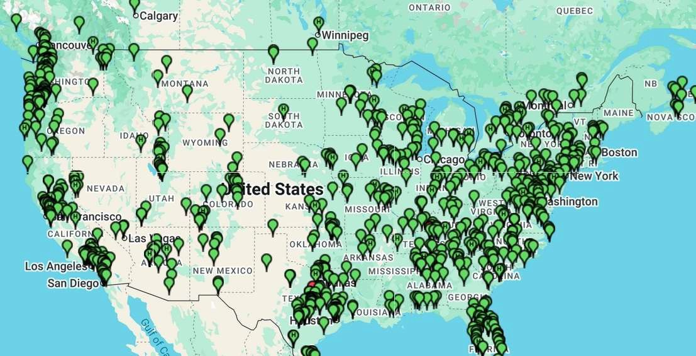
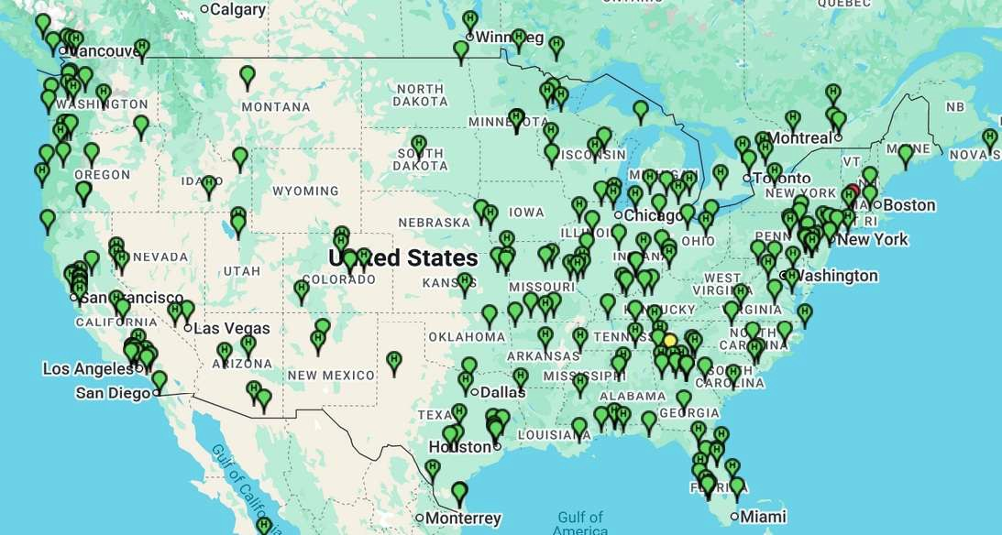
WINLINK Gateways
https://winlink.org/RMSChannels VARA FM Gateways in USA
VARA HF Gateways in USA

Slide 5
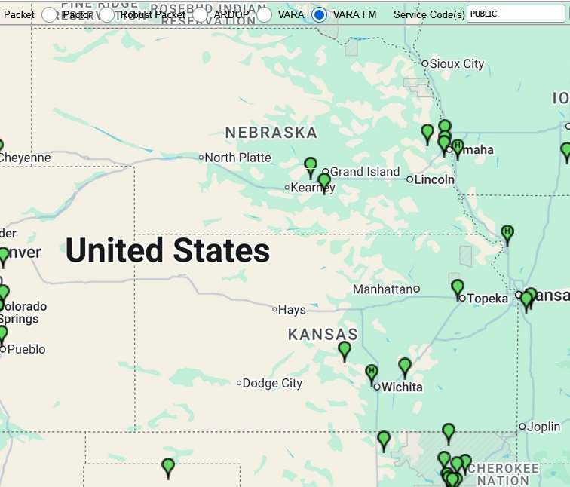
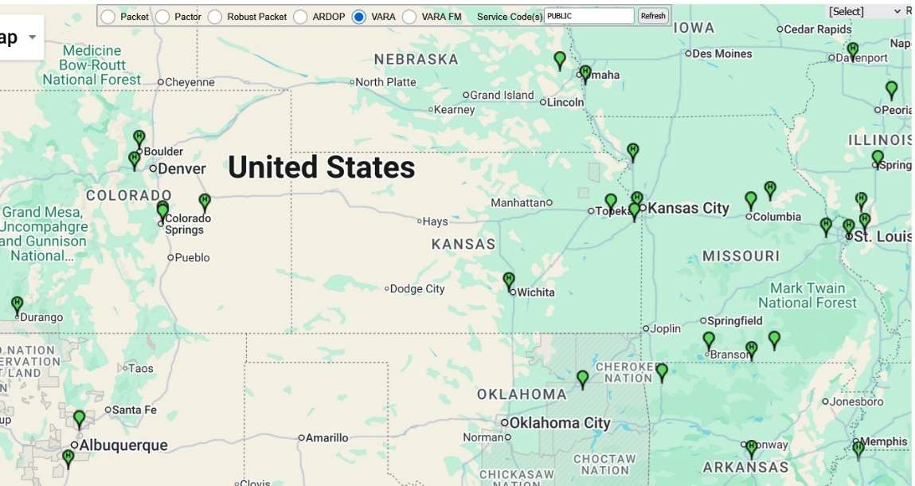
VARA Gateways in Kansas
VARA FM Gateways in Kansas
VARA HF Gateways in Kansas

Slide 6
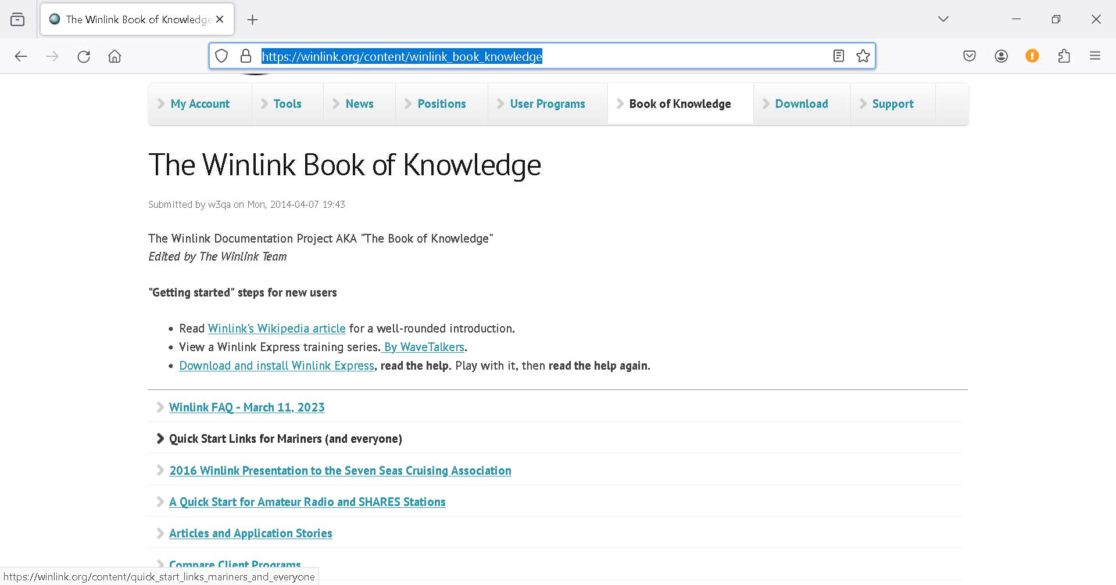
The Winlink Book of Knowledge
https://winlink.org/content/winlink_book_knowledge

Slide 7
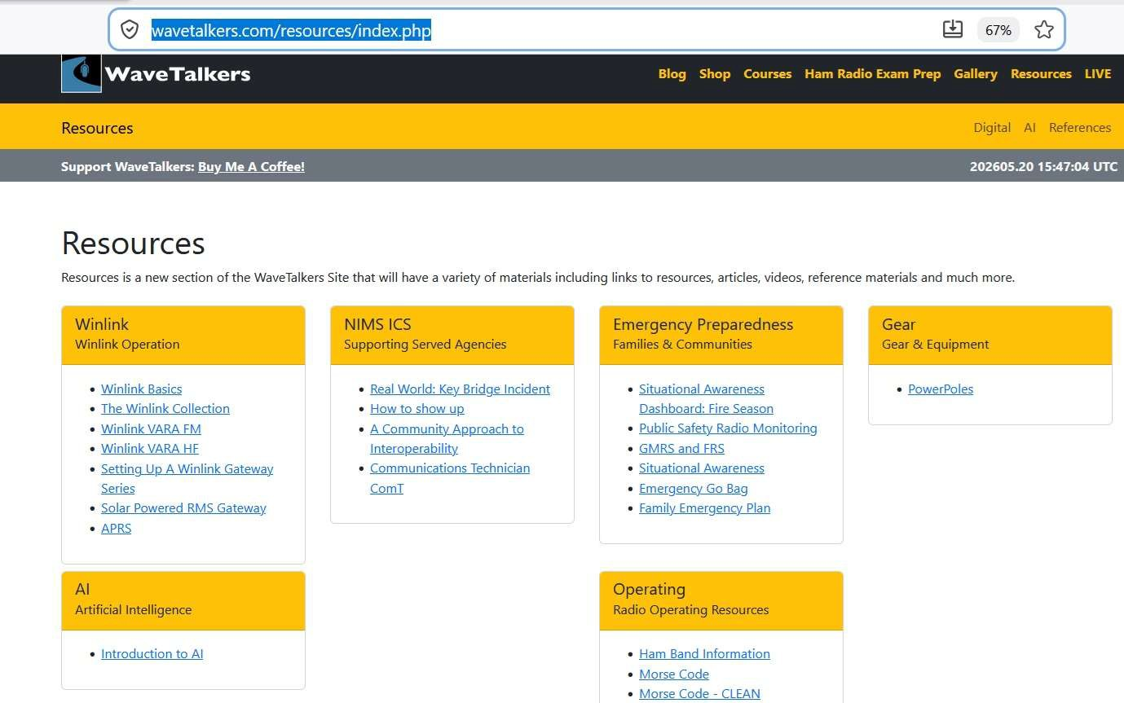
Wavetalkers
The Wavetalkers Group has a great website https://wavetalkers.com/ which contains links to resources for learning and operating Winlink.
https://wavetalkers.com/resources/index.php

Slide 8
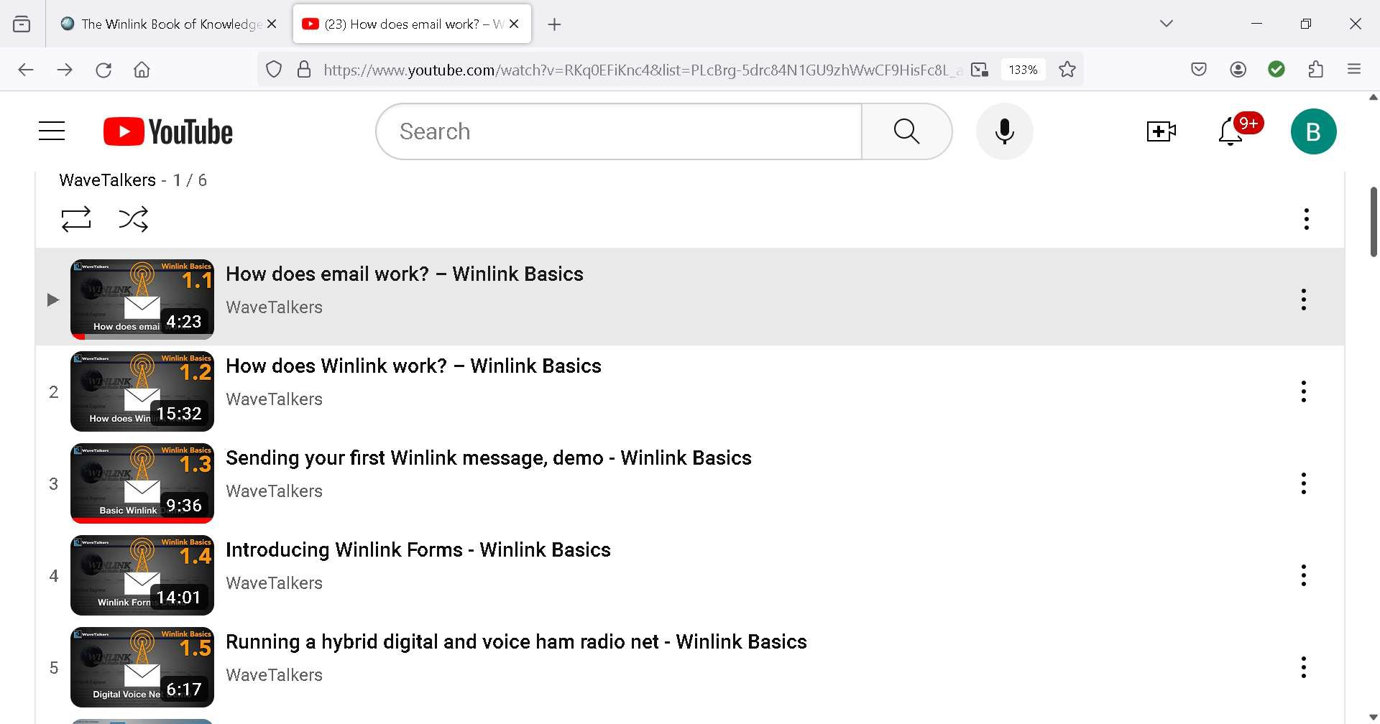
The Wave Talkers also have Youtube videos demonstrating how to install and operate Winlink hardware and software. They have Live Youtube videos in which you can participate and send your Winlink Form Emails
https://www.youtube.com/watch?v=RKq0EFiKnc4&list=PLcBrg-5drc84N1GU9zhWwCF9HisFc8L_a

Slide 9
The Infrastructure of an FM Gateway, HF Gateway and Winlink Post Ofice Architecture
RMS Packet software is used to manage an FM Gateway in Winlink. The Gateway sends the email by the Internet by default and if Internet down a designated HF Throughput is designated. Vara FM is the virtual modem software used to send and receive the emails over FM. Vara FM must be conﬁgures with a sound card and the connection must be tested using Ping and the Autotune to ensure the VU meter is between 60-80 percent.
RMS Relay is used to hold and manage emails and attachments when either the HF Gateway or the Internet is not available and is used with RMS Packet. If the Internet is down and HF Throughput not available then the software can acts as a Post Ofice, holds the email and permits Operators to send and pick up their emails from a local server
RMS Trimode is software that is used to manage an HF Gateway and throughput. The software scans designated HF frequencies assigned to the Gateway to receive and transmit emails to the CMS (Central Management Server) Vara HF is the virtual modem software used to send and receive emails of HF. The connection must be tested using the VU Meter in Vara is between 60-80 percent.

Slide 10
Winlink Setup Conﬁguration – KD0WAU – B. Schlueter
Service | Radio | Platform | Interface Cables | Software Required | Transmission Activity
Vara FM Gateway | Kenwood FM V71 | Both Gateways on Windows 11 Mini Disc 500 GB 51 used | Kenwood Digirig | RMS Packet, Vara FM | FM Gateway Uses VHf to receive transmissions and sends to CMS over Internet using Telnet. If Internet down it will send over HF if connected (Hybrid station). If not HF it will either hold or reject received transmission.
Vara HF Gateway | Yaesu FT-857 |  | Yaesu Digirig | RMS Trimode, VaraHF, RMS Relay | Receives over HF and transmits over Internet if Internet down will send over HF
Local Post Office | Yaesu FT- 857 | Latop HP Pavilion Windows 10 TB | Yaesu Digirig | RMS Packet, Vara FM, RMS Relay | Turn off Internet on all radios during testing for Post Office

Slide 11
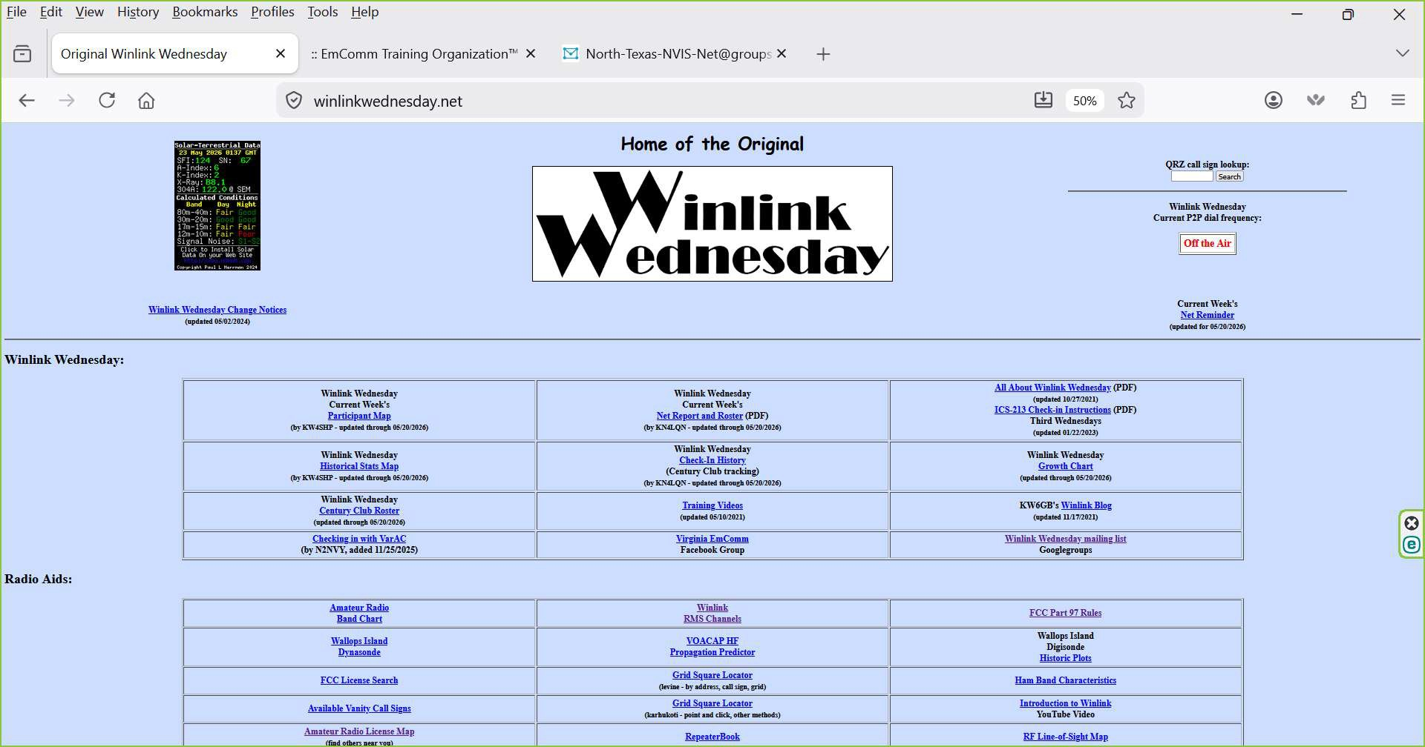
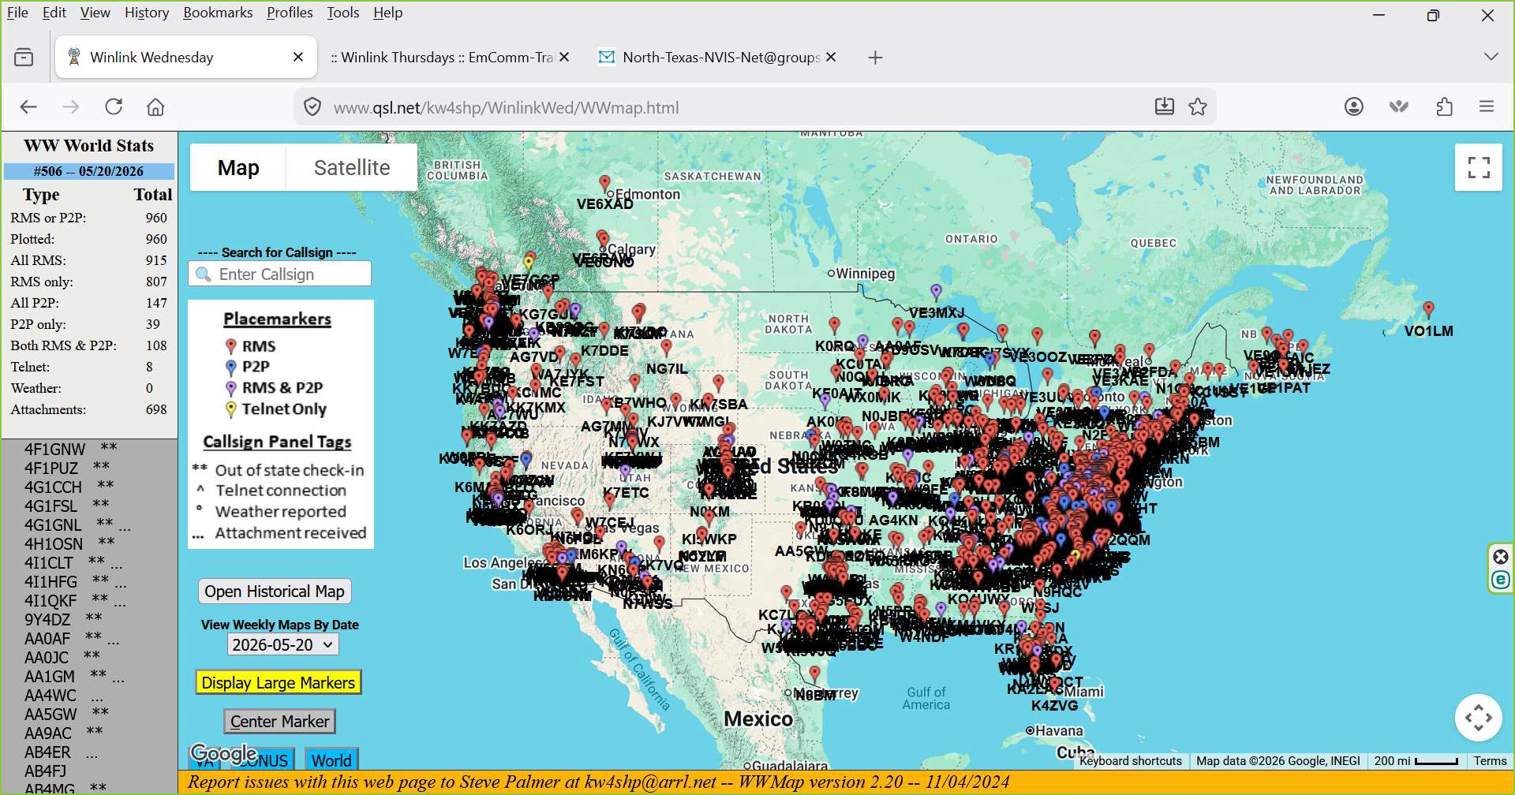
Where and How to Practice Winlink Wednesday
https://winlinkwednesday.net/
Participation Map

Slide 12
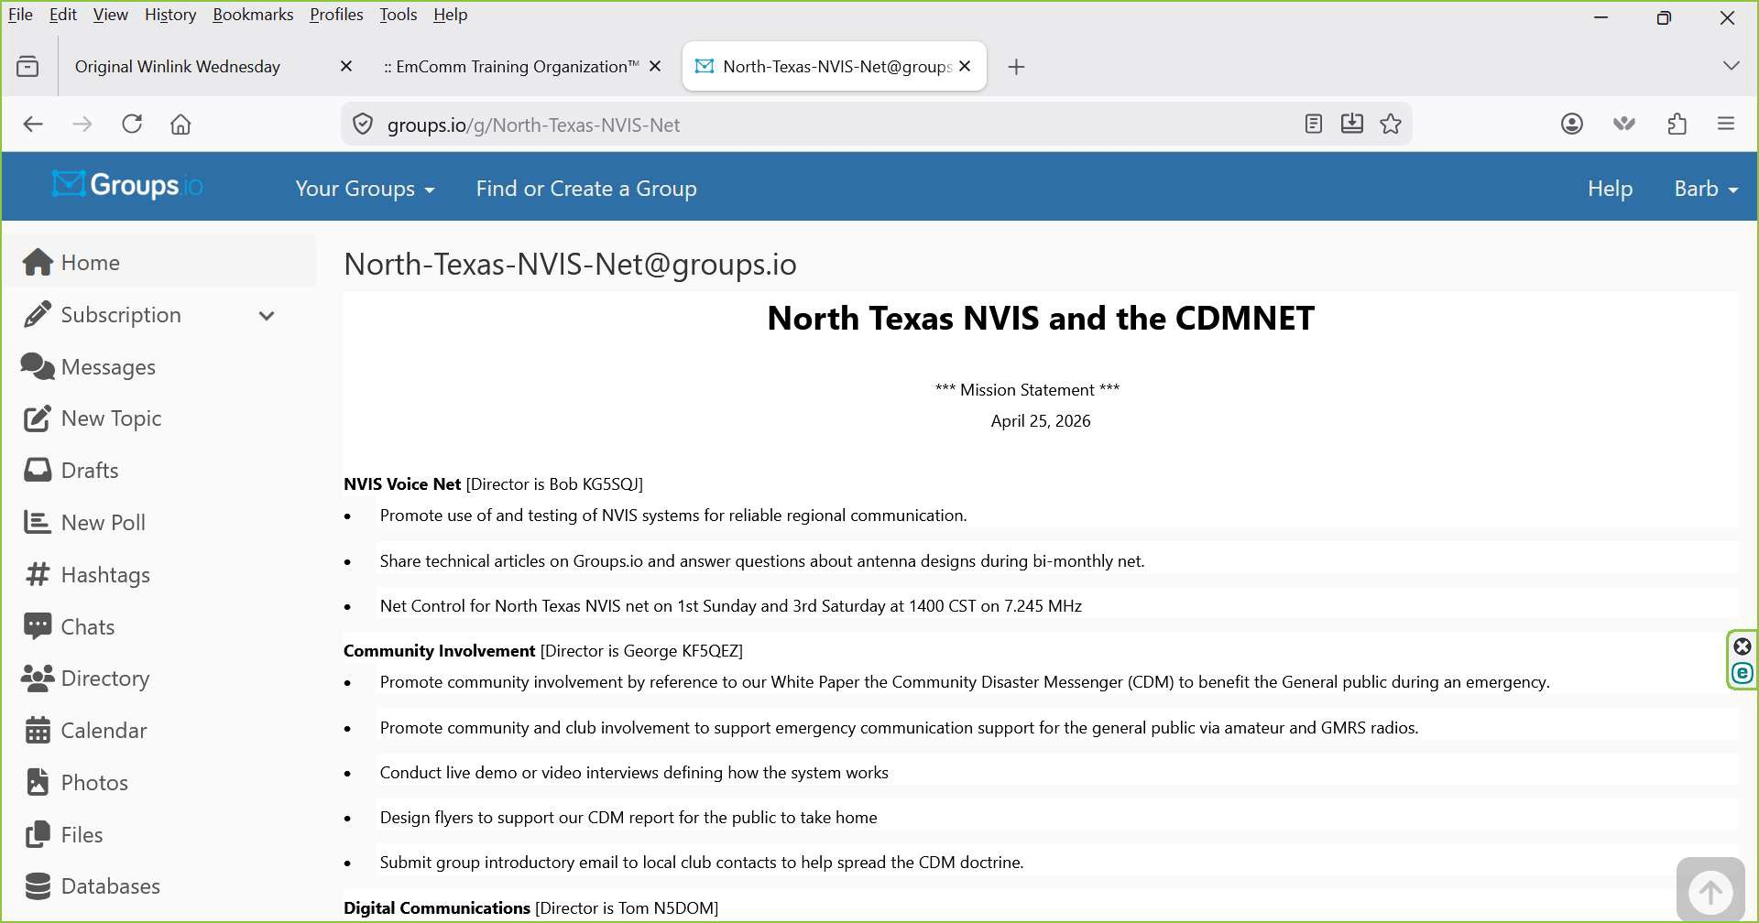
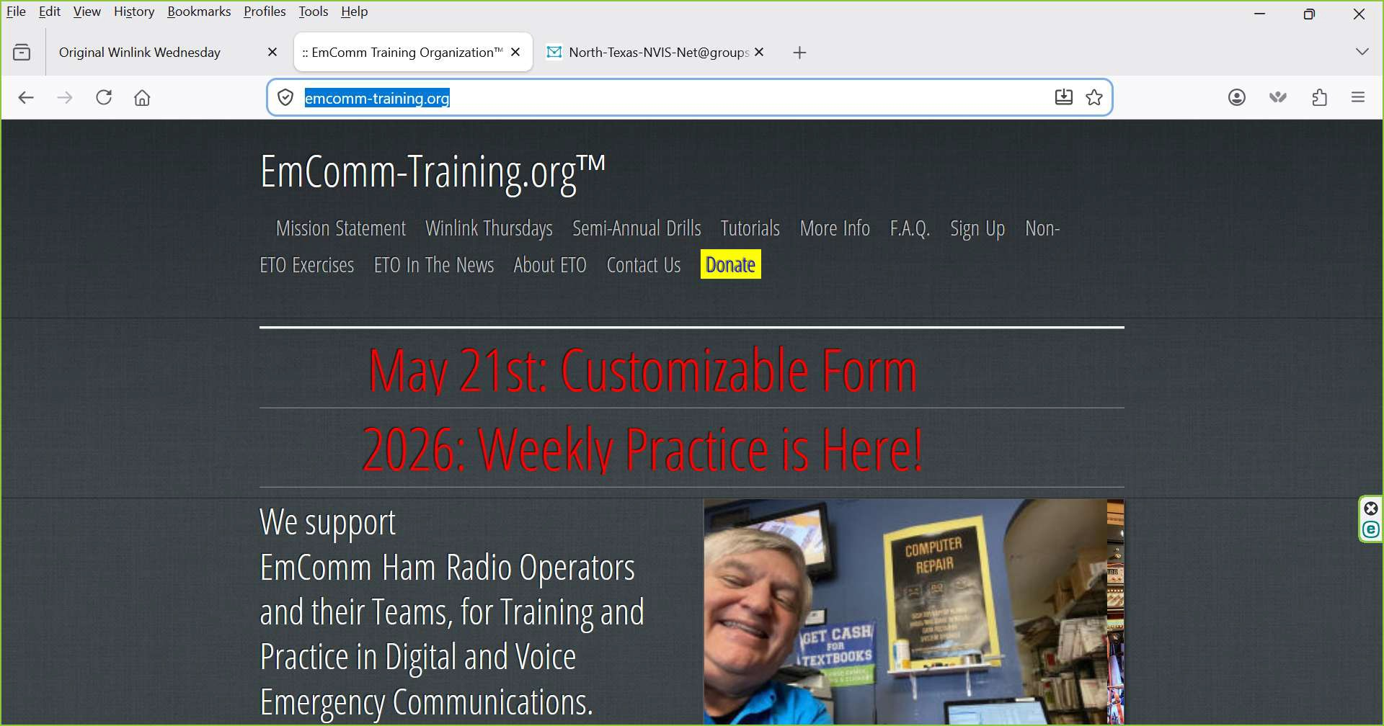
North Texas – NVIS antenna group on groups.io
Emergency Communications Training
https://emcomm-training.org/

Slide 13
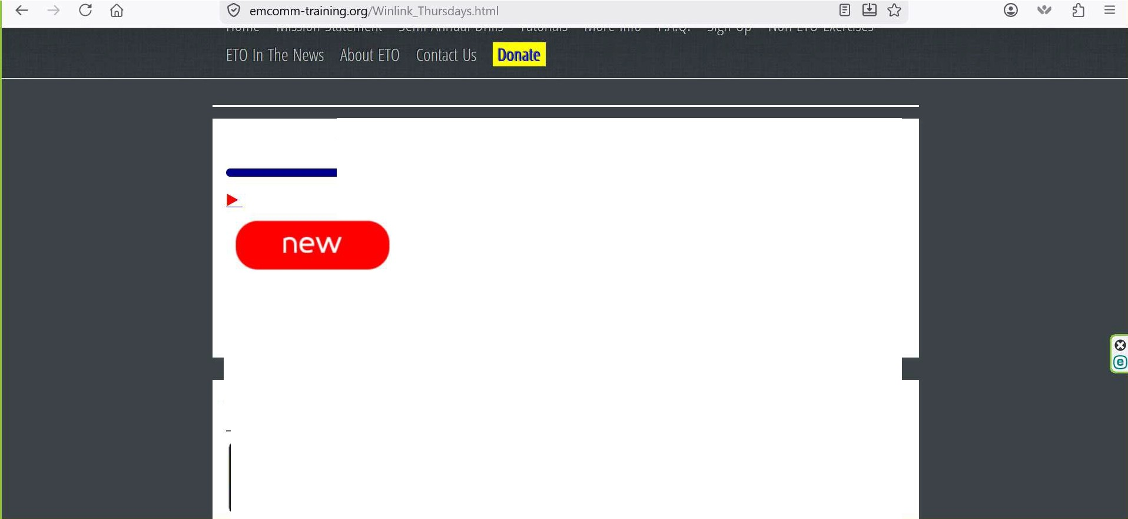
file .!::dit Yiew Hi�tory ftookmarks £rofiles Iools .!::!elp
X :: Winlink Thursdays:: EmComm-Tra X � North-Texas-NVtS-Net@groups X +
ell X
[:j Original Winlink Wednesday
Winlink Thursdays: Now Every Week, Still Always Optional
[Clickonabove►or this link toexpand its contents]
EmComm-TrainingJ1IgAnnounces new Weeki�Practice exercises for
2026!
WinlinkThursdays: How Do They Work?
iJ ,.Step One: Fi.ndyour'Cle�ri�ghouse Tacti_cawl inlinkAddresshere...
,.,o••mo• Step Two: This Weeks Winlink Thursday assignment:

