Slide 1
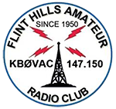
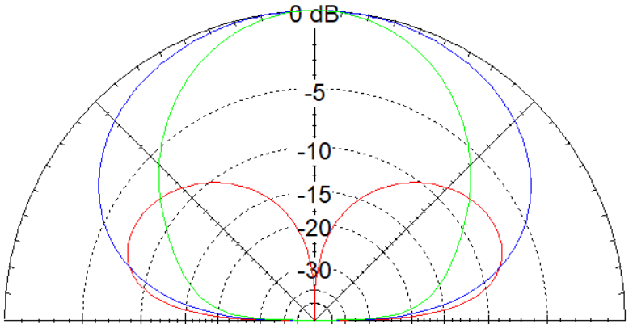
NVIS Near Vertical Incident Skywave

Slide 2
NVIS Near Vertical Incident Skywave

Slide 3
Near Vertical Incident Skywave (NVIS)
Introduction:
Of all the variables affecting communications, the one factor that we as individual operators have the most control over is the antenna and its use.

Slide 4
Near Vertical Incident Skywave (NVIS)
Discussion:
Near Vertical Incident Skywave (NVIS)
Its use
Some antennas we can use to exploit this HF propagation mode

Slide 5
Near Vertical Incident Skywave (NVIS)
Propagation is the process by which a radio signal travels through the atmosphere from one antenna to another.
In High Frequency Communications, this is accomplished by:
Ground-Wave
- Ground wave communications can be established out to about 20-30 kilometers (km) or 12-18 miles with low-powered radios (approx. 20W). High-powered radios (approx. 400W) can extend that range to about 80-100km or 50-62 miles.
Sky-Wave
- Sky wave communications (best known for DX) can vary between several kilometers to thousands of kilometers.

Slide 6
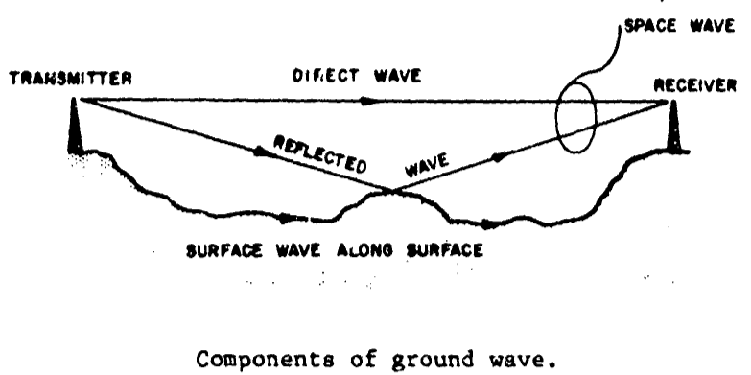
Near Vertical Incident Skywave (NVIS)
Ground-wave propagation involves the transmission of radio signals along or near the earth’s surface and can be divided into three parts:
Direct Wave
Reflected Wave
Surface Wave

Slide 7
Near Vertical Incident Skywave (NVIS)
HF Propagation Modes:
Direct Wave (Line-of-Sight)
Frequencies – Fairly Constant
Fairly Large Range of Freqs
Wavelengths = Large Antennas
More noise than higher freqs
Effective Range with Antenna at 10 ft AGL: 6.5 to 8 km or 4 to 5 miles

Slide 8
Near Vertical Incident Skywave (NVIS)
HF Propagation Modes:
Ground or Surface-Wave
Range impacted by:
Surface Conductivity & Freq
Very effective over salt water
Poor performance over sand,
rocky, frozen ground, in heavy
vegetation or in mountainous
terrain.
Lower frequencies work best
Theoretical Range: (150W)
Freq: 7MHz 30MHz
Land: 22 mi 8 mi
Sea: 155 mi 62 mi

Slide 9
Near Vertical Incident Skywave (NVIS)

Slide 10
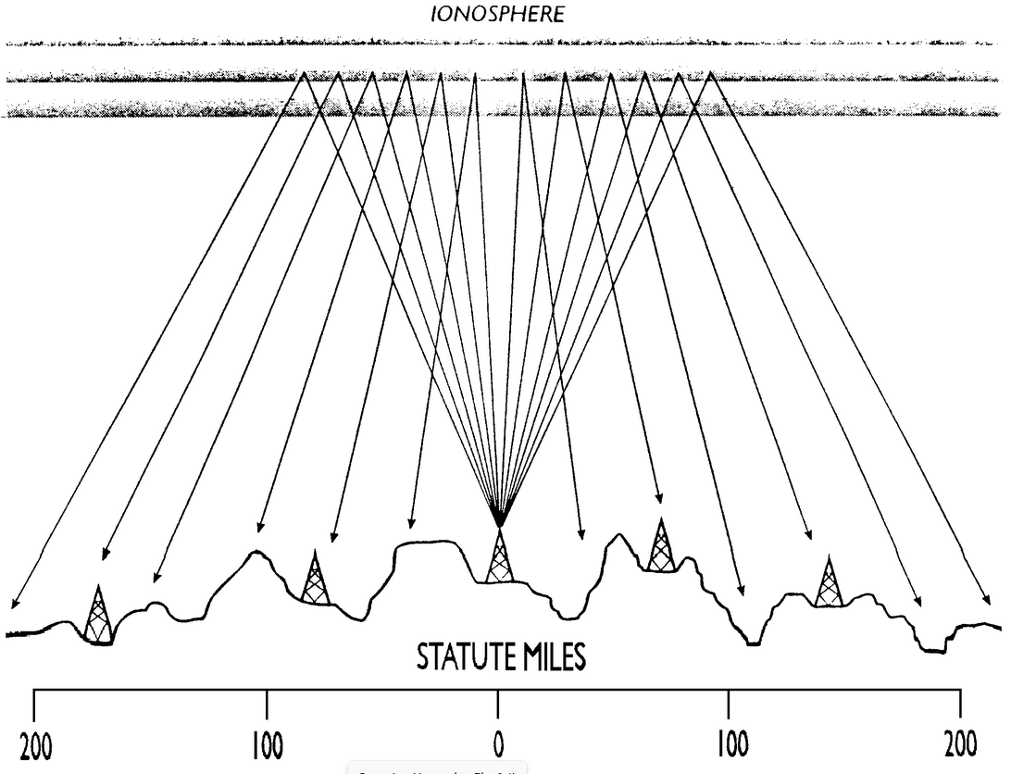
Near Vertical Incident Skywave (NVIS)
Near Vertical Incident Skywave (NVIS) is a special mode of HF propagation in which signals are transmitted towards, and returned from the ionosphere almost vertically to provide local or regional coverage.

Slide 11
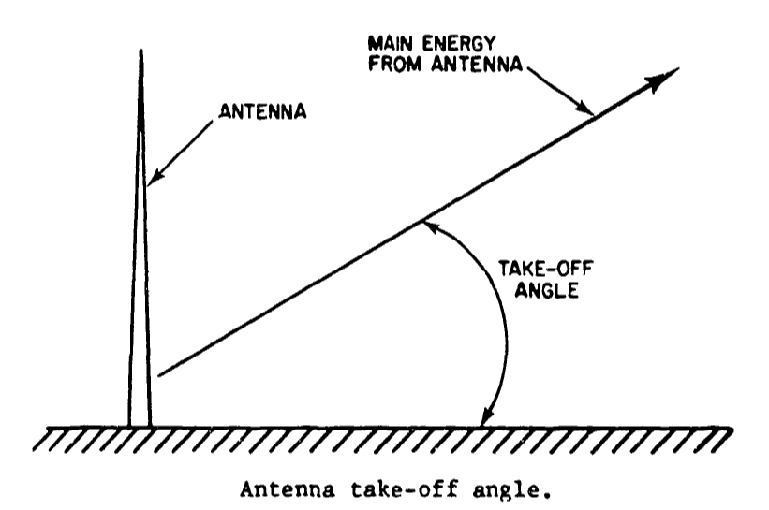
Near Vertical Incident Skywave (NVIS)
NVIS typically requires a Take-Off Angle
between 75 and 90 degrees

Slide 12
Near Vertical Incident Skywave (NVIS)

Slide 13
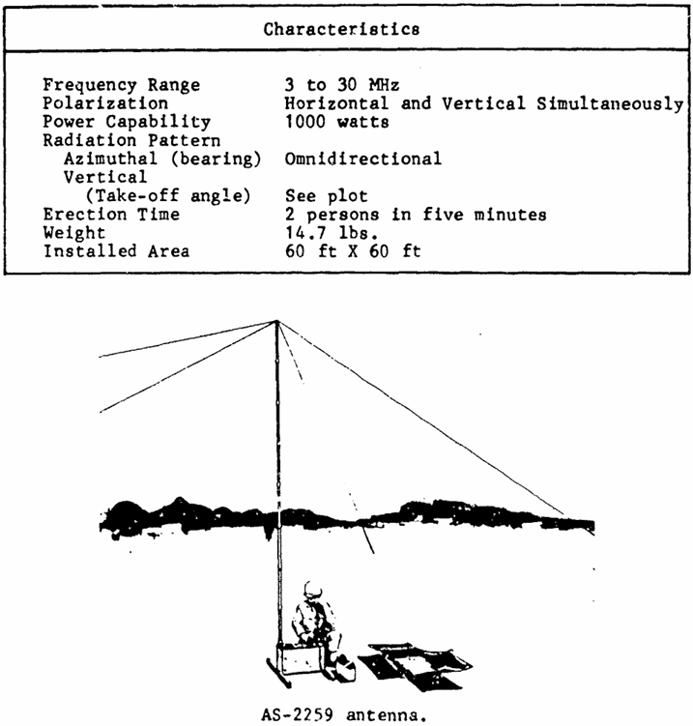
Near Vertical Incident Skywave (NVIS)
AS-2259
Military Antenna
Consists of two crossed
sloping dipoles or inverted Vs
positioned at right angles to
each other supported at the
center by a 15ft mast.

Slide 14
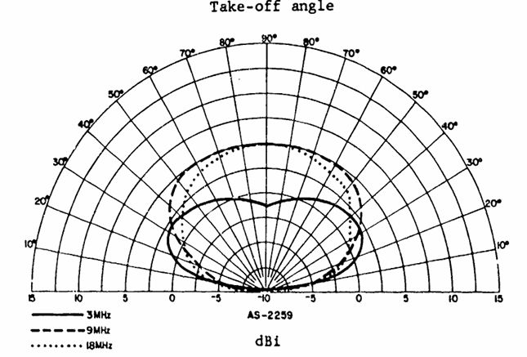
Near Vertical Incident Skywave (NVIS)
AS-2259
According to Dale Hunt WB6BYU,
(practicalantennas.com) the dipoles
are cut for about 6 to 9 MHz.
Performs fairly well on 40m (7 MHz)
and 60m (5 MHz) but drops off
below 60m.
80m (3 MHz) drops about 6dB
compared to a dipole at 15ft

Slide 15
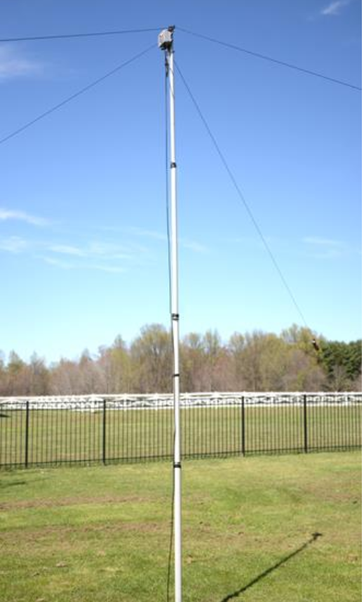
Near Vertical Incident Skywave (NVIS)
DX Engineering has a similar
NVIS antenna cut for 40m and
80m
Footprint: Approx 158 feet by
75 feet.

Slide 16
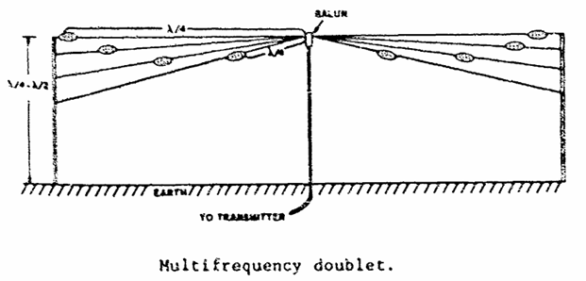
Near Vertical Incident Skywave (NVIS)
Halfwave Dipole or Doublet
Horizontally polarized antenna
used for short and medium length
skyway paths up to about 1200 mi
Balanced resonant antenna
Produces max gain for narrow
range of frequencies. (+/- 2% fm design)
Highly versatile
Adjusting antenna height above ground
changes gain and take-off angles for short
or medium path-length

Slide 17
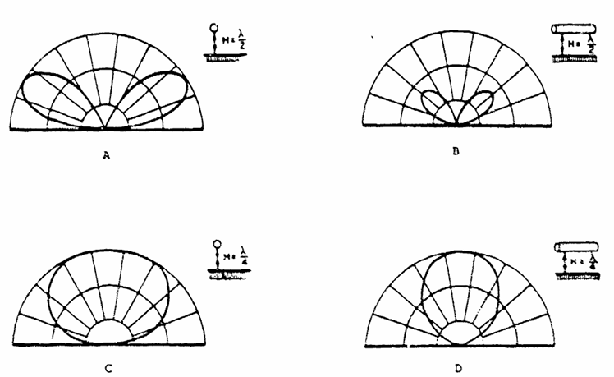
Near Vertical Incident Skywave (NVIS)
Half wave length high
Medium-path length
Bi-directional
Feed point: Z = 50 ohms
Gain: 2.15 dBi over isotropic
Quarter wave length
Short-path length
Omni-directional
Feed point: Z decreases
Efficiency & gain decreases

Slide 18
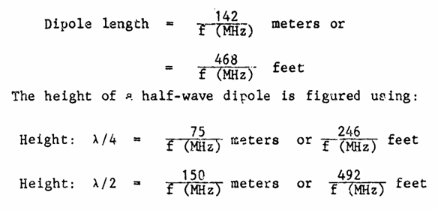
Near Vertical Incident Skywave (NVIS)

Slide 19
Near Vertical Incident Skywave (NVIS)

Slide 20
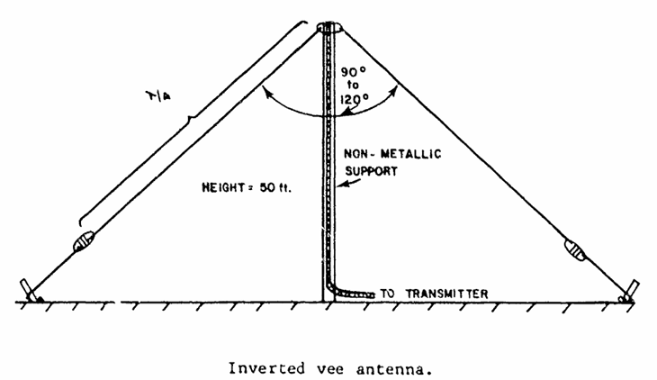
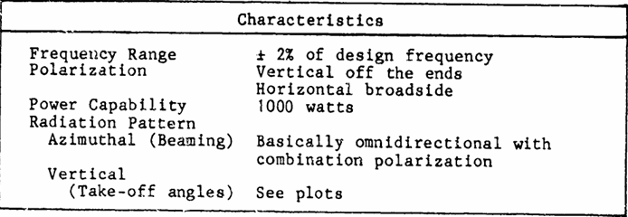
Near Vertical Incident Skywave (NVIS)
Inverted Vee Dipole
Same length as regular dipole
Same considerations as to height
above ground apply.
Sloping orientation of wires cause
antenna to have both horizontal &
vertical polarization
Less gain than a dipole
Radiation pattern is more omni-
directional
Favors regional and local contacts

Slide 21
Near Vertical Incident Skywave (NVIS)

Slide 22
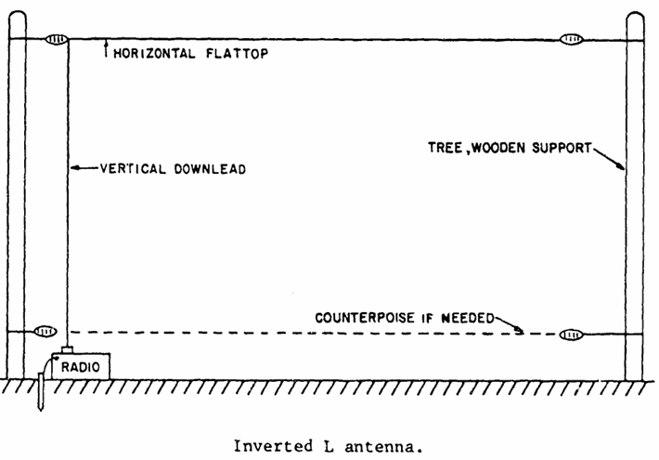
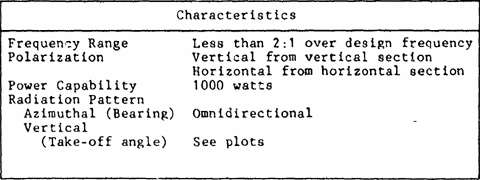
Near Vertical Incident Skywave (NVIS)
Inverted L
Combination antenna made up of a vertical
and a horizontal section
Omnidirectional radiation for ground wave
from vertical section
High-angle radiation from horizontal section
for short-range sky-wave
Supports a narrow range of frequencies

Slide 23
Near Vertical Incident Skywave (NVIS)
Inverted L
Can be used as a substitute for a dipole
Has less gain and radiation pattern varies
with frequency (unlike a dipole)
Using vertical height of 35-40’ and the
following lengths will provide reasonable
performance.

Slide 24
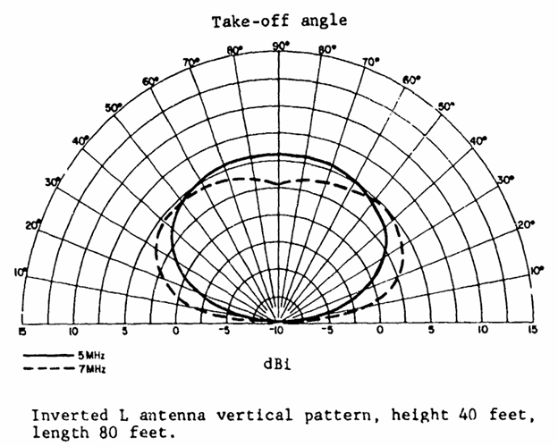
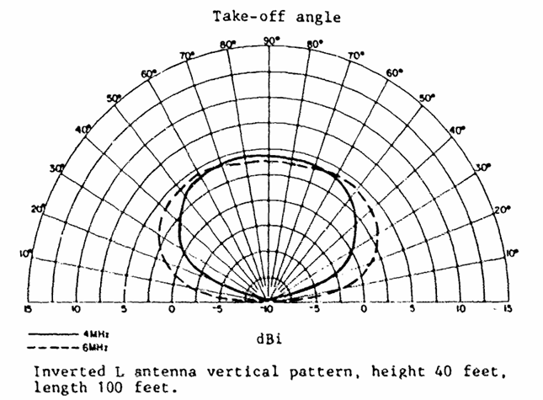
Near Vertical Incident Skywave (NVIS)

Slide 25
Near Vertical Incident Skywave (NVIS)
Large Loop Antenna (Sky wire)
One wavelength in circumference at
the fundamental resonant frequency
Multiband by nature
A loop antenna is resonant on integral
harmonics of its fundamental frequency
Example:
An 80m loop will have resonant points
on the 43, 30, 20, 17, 15, 12 & 10 meter
bands

Slide 26
Near Vertical Incident Skywave (NVIS)
Large Loop Antenna (Sky wire)
Omnidirectional
Exhibits NVIS radiation patterns at NVIS
frequencies & low angle radiation
patterns at DX frequencies
Exhibits gain
Resistant to atmospheric and man-
made noise/interference

